Slide 1
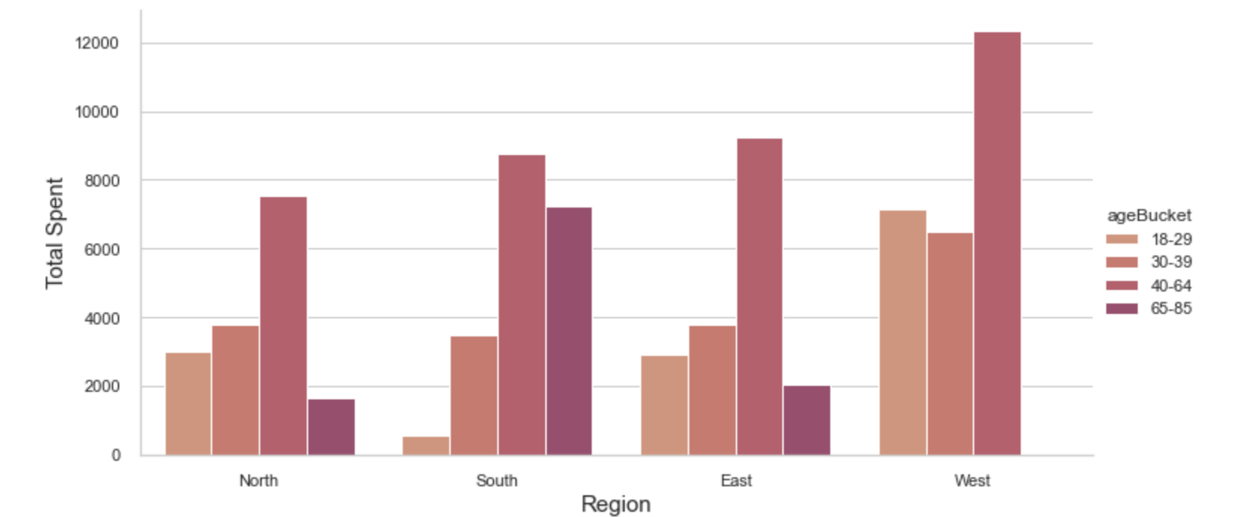
Blackwell Electronics
Prepared by: Holly Livingston
Data Analysis Report
There are differences in age between regions and each age group has a different buying pattern.
With our prediction model, we are able to predict the age of a customer in a region with an accuracy of about 84%. It is important to note that older populations in the west do not purchase our products.

Slide 2
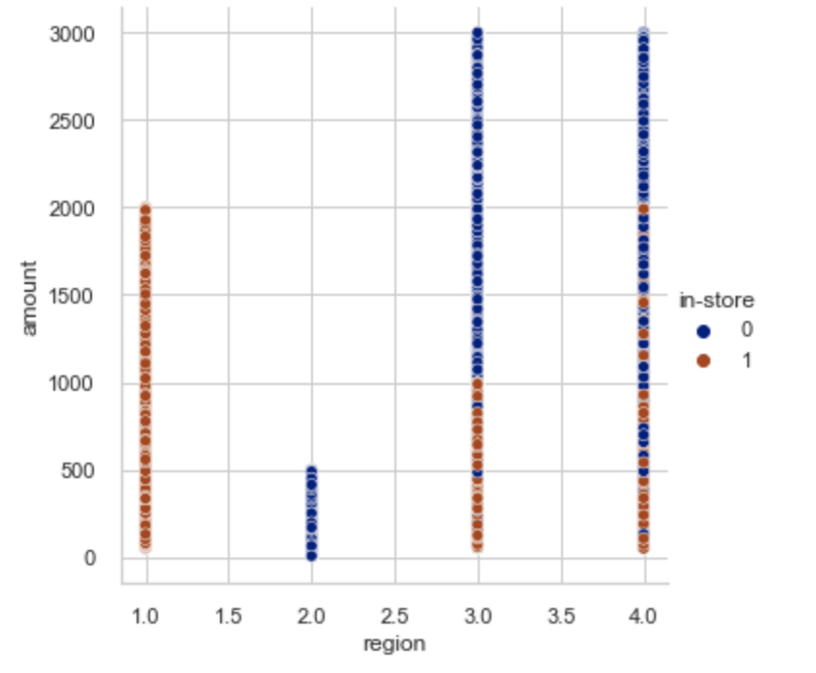
Blackwell Electronics
Prepared by: Holly Livingston
In store or Online?
At first glance, it seems there is no correlation between age and store. But using our model, we are able to see that north region is entirely online and south is all in-store. For east and west regions, it is important to note that in-store purchases stay under $2,000.

